Slide 1
A holistic insight to Tableau

Slide 2
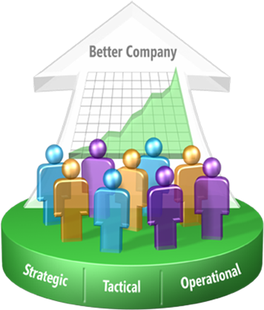
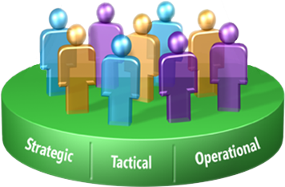
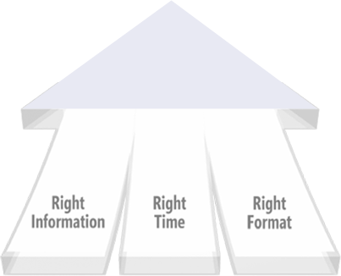
What is BI?
Improving organizations by providing business insights to all employees leading to better, faster, more relevant decisions

Slide 3
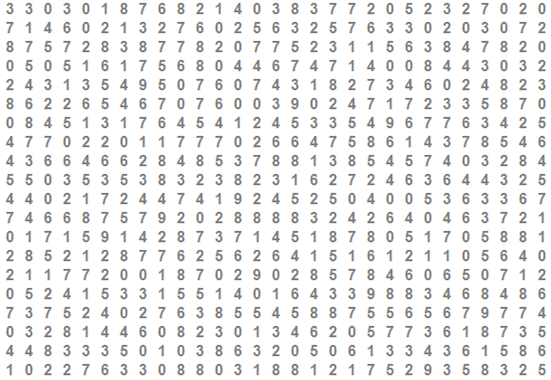
Human Perception is Powerful

Slide 4
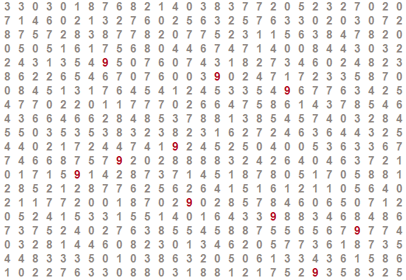
Human Perception is Powerful

Slide 5
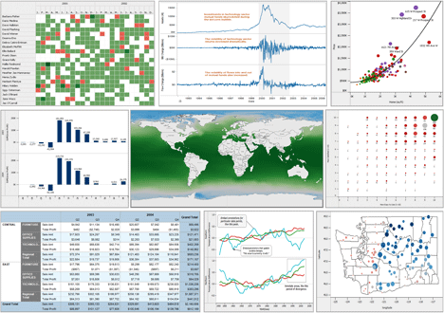
What is Tableau?
Tableau enables users to quickly see and understand their data by automatically turning data into pictures

Slide 6






Why Tableau?
Fast
Easy
Secure
Everyone
Everywhere
Cost Effective
Notes:
Explosion of Data
Number of data sources
BIG Data
Real-time
Proliferation of Devices
Tablets / SmartPhones
New Interaction Paradigms
Cloud Computing
Streamlined Deployment / Scale
Cloud Data Sources
Social Networking / Collaboration

Slide 7
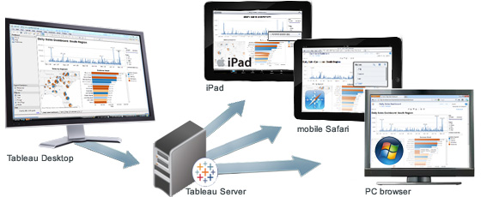
Tableau’s Visual Intelligence Platform
Server
Consume
Desktop Create
Mobile
Web
Desktop
Connect to data in:
Server
Standardize

Slide 8
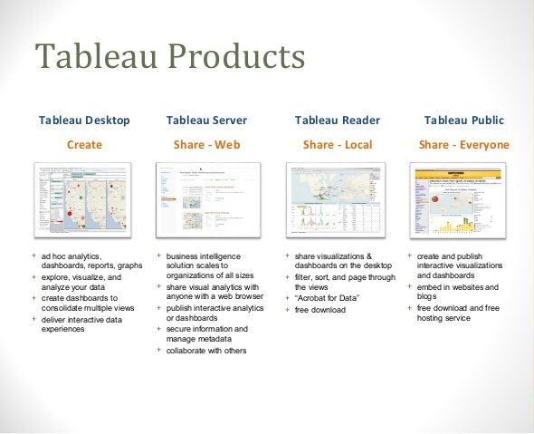
Tableau Products

Slide 9
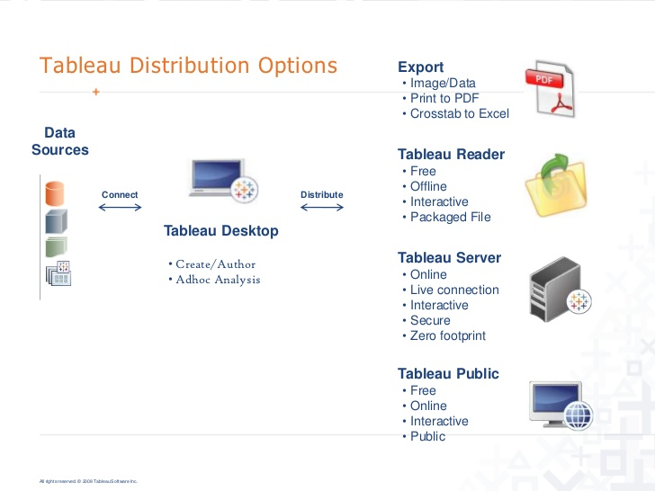
Tableau Products

Slide 10
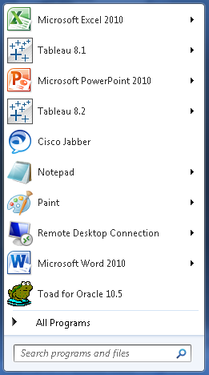
Starting Tableau
Click Here to Start Tableau 8.2

Slide 11

Depiction of different Data Types
String Field
Number Field
Date Field
Geography Field
Bin Field
Set Field
Group
Calculated String Field
Calculated Number Field
Hierarchy

Slide 12
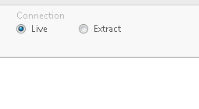
Type of Connections
Tableau Data Extract
Performance - Enhanced
Offline analysis - Possible
Creating packaged workbooks - Possible
Publishing to Tableau Public - Possible
Data security – Enhanced
Interactive Analysis - Possible
Live Connection
Data is Live
Online Analysis - Possible
Performance - hampered
Can’t connect to large data – Performance degraded drastically
Creating packaged workbooks – Possible
Interactive Analysis – Slightly hampered

Slide 13
Thank You !!!

